Slide 1


shodwe
HoteL
Group 4
HOSPITALITY ANALYTICS

Slide 2

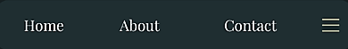

Hotel
shodwe
Your Stay Begins with Our Smile

Slide 3

5) Vikrant banode 6) Santosh abithan 7) swagatika satpathy
Group 4
1) Adyasa Priyadarsini Acharya 2) Snehlata Choubey 3) Makala Deepak 4) Saurabh Jondhale

Slide 4

SHODWE analytics
modules
excel
sql
Power bi
tablue

Slide 5

Overview
Hospitality Analytics helps hotels analyze bookings, revenue,
occupancy, and cancellations. The project uses SQL to extract
KPIs like
total revenue, occupancy rate, and cancellation trends . Excel dashboards provide pivot-based visualizations
for quick performance tracking. Tableau dashboards deliver Interactive insights with city-wise, category-wise, and time-based analysis.
Power BI dashboards allow real-time monitoring with dynamic filters and drill downs. Overall, the project supports data-driven decision-making to boost efficiency and maximize revenue.

Slide 6
Kpi’s
Total Revenue
Occupancy Rate
Cancellation Rate
Total Bookings
Utilized Capacity
Trend Analysis
Weekday & Weekend Revenue and Booking
Revenue by State & Hotel
Class Wise Revenue
Checked Out / Cancel / No Show
Weekly Trend – Key Metrics

Slide 7
Dashboard Highlights
This dashboard provides a comprehensive view and detailed analysis of hotel revenue performance and booking patterns, highlighting key hospitality business metrics across multiple cities, properties, room categories, and revenue classes.
Key highlights include:
Total Revenue: ₹2.01B Revenue Realized: ₹1.71B
Occupancy Rate: 57.87% Cancellation Rate: 24.83%
Total Bookings: 134,590 Utilized Capacity: 232,576

Slide 8
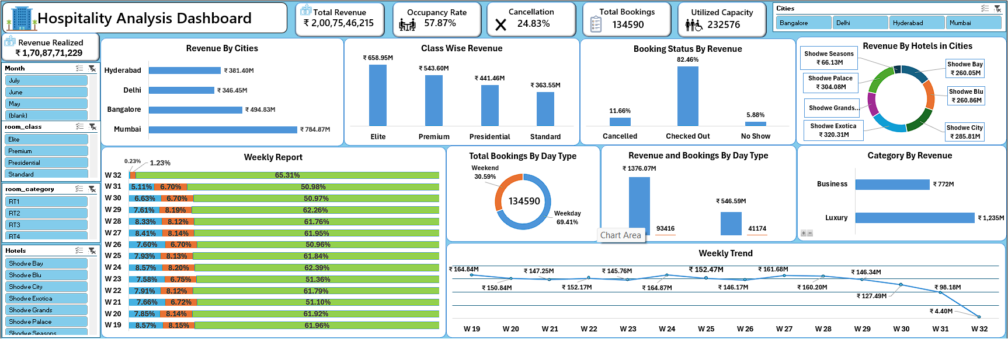
Excel dashboard
Insights
City-Wise Revenue Performance
Mumbai: ₹784.87M (Highest)
Followed by Bangalore, Hyderabad, and Delhi.
Top Performing Hotels
Shodwe Bay: ₹260.65M
Shodwe Seasons: ₹66.13M
Shodwe Exotica: ₹320.31M
Contribution from 6 hotels is visualized via a donut
chart.

Slide 9
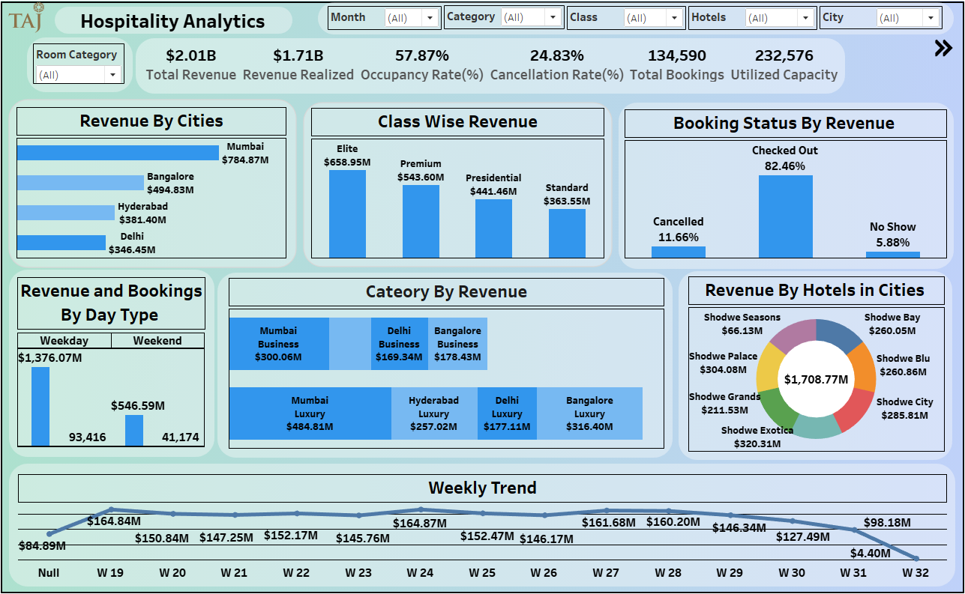
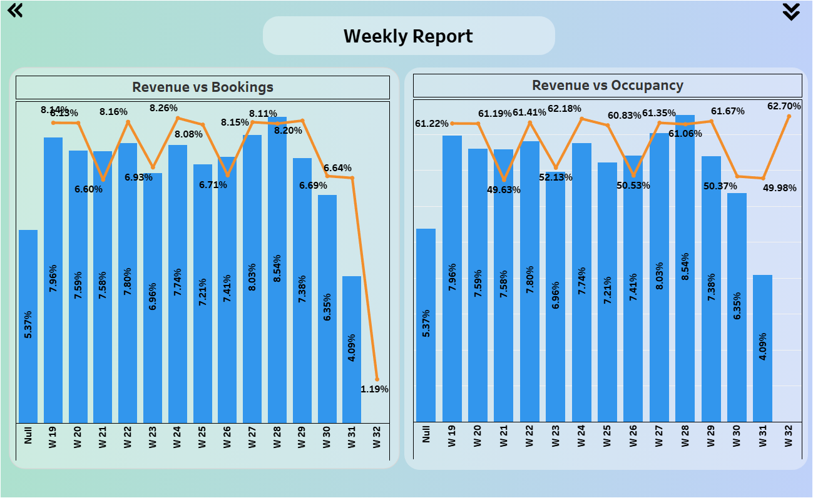
Tableau dashboard
Insights
Top City: Mumbai leads with ₹784.87M revenue.
Top Class: Elite rooms generate the highest revenue (₹658.59M).
Booking Behavior: 82.46% of guests checked out successfully, with
minimal no-shows.
Revenue by Day Type: Weekdays dominate with ₹1.37B
compared to ₹546.59M on weekends.
Category Trends:
Luxury Segment: Highest in Mumbai (₹484.81M)
Business Segment: Strong in Mumbai (₹300.06M) and
Bangalore (₹178.43M)
Hotel Performance: Shodwe Exotica (₹320.31M) and Shodwe
Palace (₹304.08M) lead revenue generation
Weekly Trend: Stable weekly performance with peaks around
Week 26–28.

Slide 10
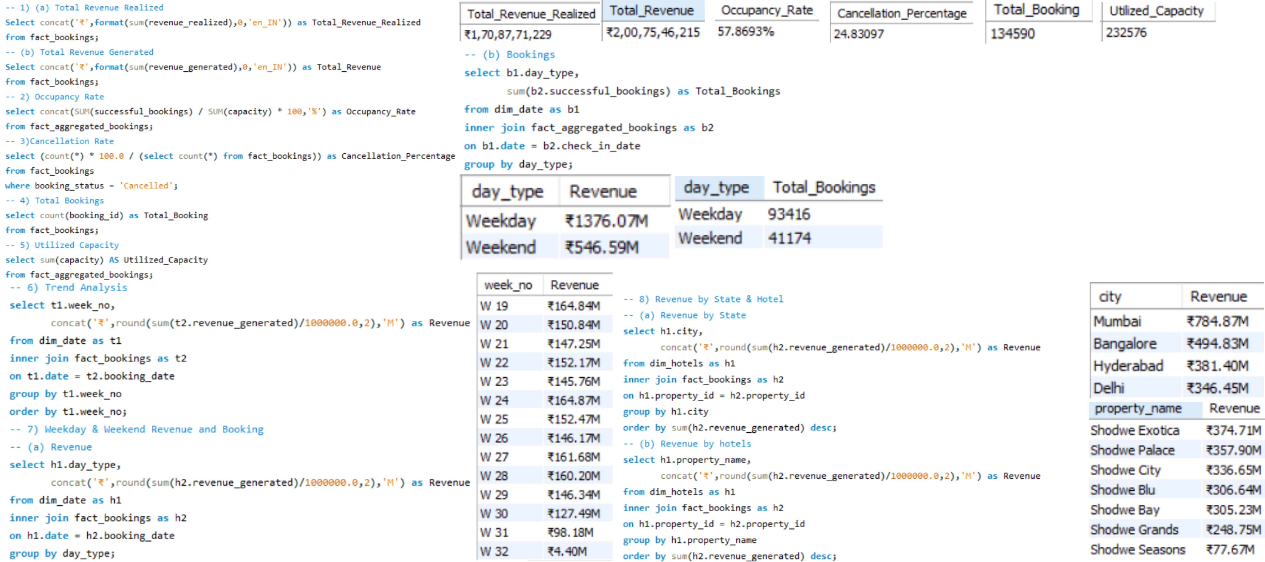
SQl Queries

Slide 11
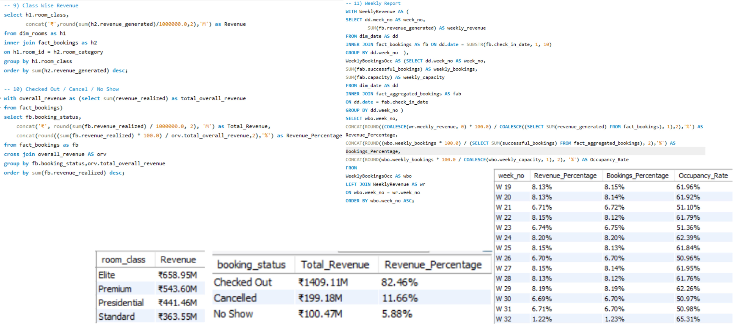
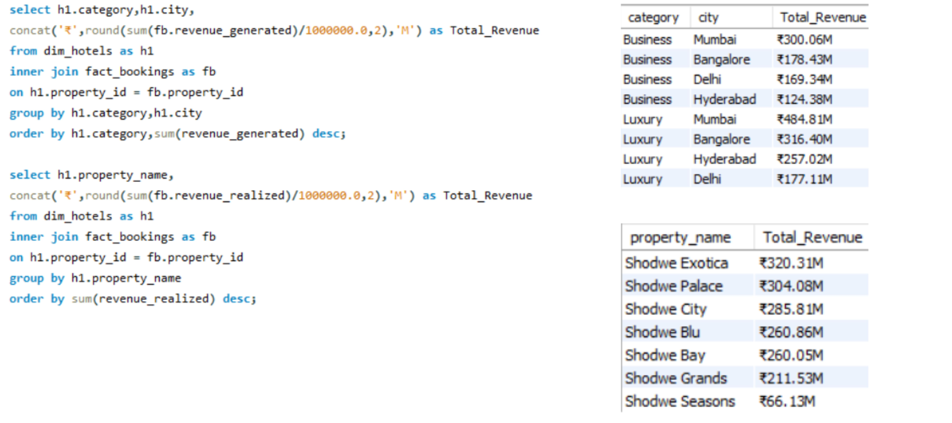
SQl Queries

Slide 12
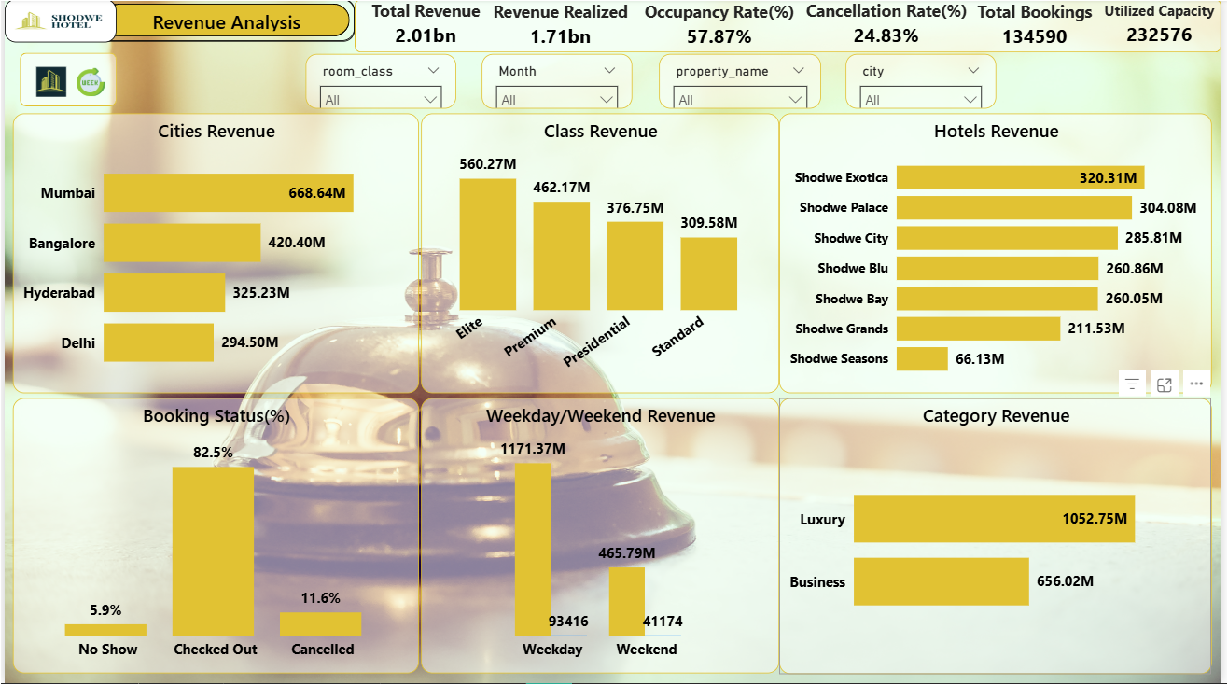
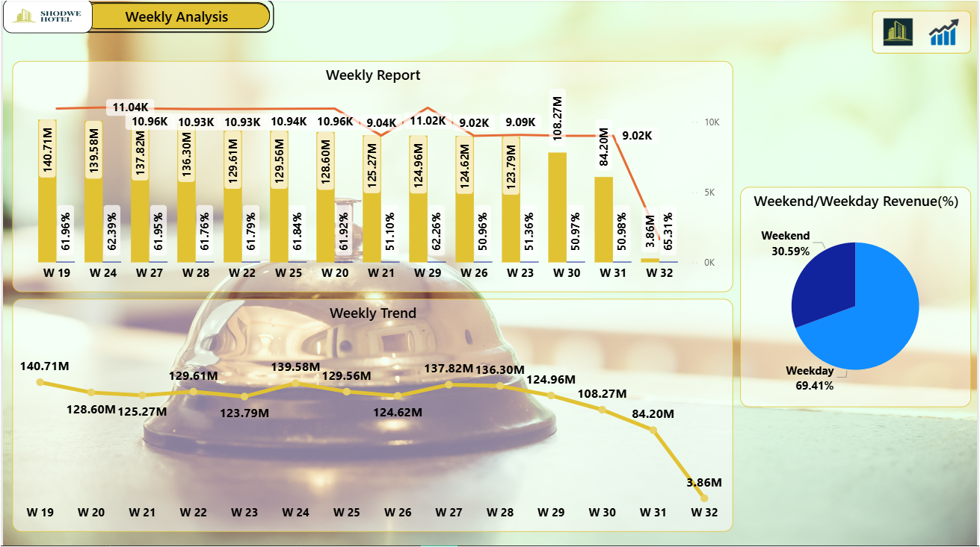
Power bi dashboard
Insights:
Top Performing City: Mumbai (₹668.64M revenue)
Highest Revenue Class: Elite (₹560.27M)
Leading Hotel: Shodwe Exotica (₹320.31M)
Category Trend: Luxury segment dominates with ₹1052.75M
Customer Behavior: 82.5% of bookings checked out successfully
Revenue Pattern: Weekday bookings (₹1171.37M) outperform weekends.

Slide 13
Key takeaways
Data-Driven Insights: Hospitality analytics helps track and improve hotel performance through data from Excel,
SQL, Power BI, and Tableau.
Revenue Optimization: Achieved ₹1.70B realized revenue with potential of ₹2.00B total revenue.
Operational Efficiency: Occupancy Rate of 57.86% shows moderate utilization; opportunities exist to boost
booking conversion.
Customer Behavior: 24.83% cancellation rate highlights the need for better booking policies and retention
strategies.
Top Performers: Mumbai and Shodwe Exotica lead in revenue generation and occupancy.
Strategic Value: Interactive dashboards enable faster decision-making, improving profitability and resource
use.

Slide 14
insights
Mumbai is the city with the highest revenue (₹668.64M revenue).
Elite room class generates the most revenue (₹560.27M).
Shodwe Exotica hotel is a top revenue earner (₹320.31M) and Shodwe Palace (₹304.08M) lead revenue generation.
Luxury segment is dominates with ₹1052.75M and Mumbai is highest revenue.
Successful bookings guest check-out rate is over 82.5% with minimal no-shows.

Slide 15
recommendations
Enhance Customer Service:
Implement Al-driven chatbots for 24/7 customer support.
Train staff on customer engagement and conflict resolution.
Market Analysis and Adaptation:
Conduct market research to identify customer needs and preferences.
Adjust strategies based on competitive analysis and market trends.
Increase Sales and Retention:
Launch personalized marketing campaigns based on customer data.
Introduce loyalty programs to reward long-term customers.
Increase sales Delhi compared to all other cities, for increase sales focus on Business Category.
Employee Engagement:
Create a positive work environment to boost employee ability to work more.
Introduce employee recognition programs to retain top talent.

Slide 16
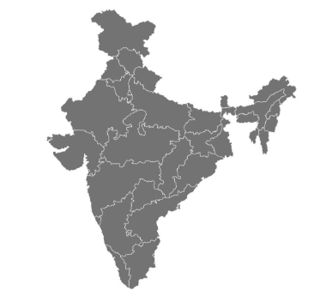
Our Location
New delhi
mumbai
Hyderabad
Bangalore

Slide 17

OUR WEBSITE

Slide 18


ABOUT HOTEL
ROOM BOOKING
MENU CARD

Slide 19
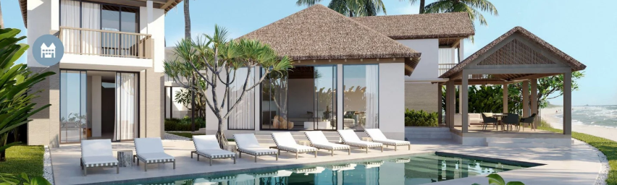
thanks
Your Comfort, Our Pleasure.

